Slide 1
Metals, Nonmetals, and Metalloids
Tuesday, September 16th, 2014

Slide 2
Do Now
Take out the form that you got signed last night. I will ask to collect them after the Do Now
Do Now
What is a metal?
What is a nonmetal?
What is a metalloid?

Slide 3
Objectives
SWBAT identify the characteristics and properties of metals, non-metals, and metalloids by completing a Venn Diagram
Essential Question
How can you use the Periodic Table to predict the properties of an element?

Slide 4
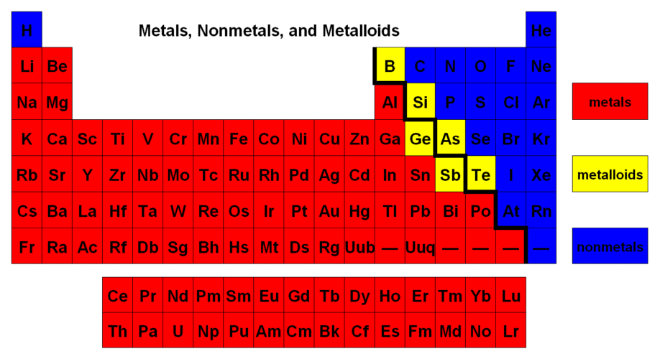
Color code the periodic table
Lightly shade each section with different colored pencils
Create a key so that you know which color represents metals, nonmetals, and metalloids
Using a marker or a sharpie, draw the zig-zag line that separates the metals and nonmetals

Slide 5
Metals
Most metals are _________ and _______
They can be _______________ into thin sheets
They can be drawn into a thin ________
Metals are ______ at room temperature
The only metal that is a _______ is _________
Metals have a low _______________
This means that they usually ________ electrons in chemical reactions
Metals have __________ properties
They are _______
They are good ____________ of heat and electricity
malleable
ductile
hammered
wire
solid
liquid
mercury
ionization energy
lose
metallic
shiny
conductors

Slide 6
Non-Metals
vary
Nonmetals ______ in appearance
Poor conductors of _____ and ___________ but good ___________
Low _______________
Have a ______ ionization energy
This means that they ______ electrons in chemical reactions
Solid nonmetals are ________
heat
electricity
insulators
melting point
high
gain
brittle

Slide 7
Metalloids
Properties are ______________ between metals and nonmetals
Metalloids are useful ________________
As the temperature ____________, the conductivity __________ increases
Can have a high or low _______________
intermediate
semiconductors
increases
also
ionization energy

Slide 8
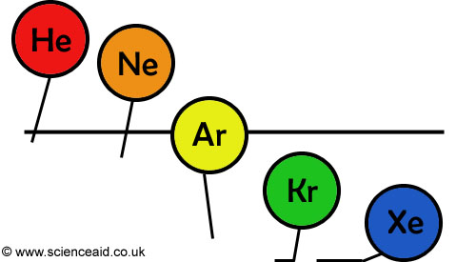
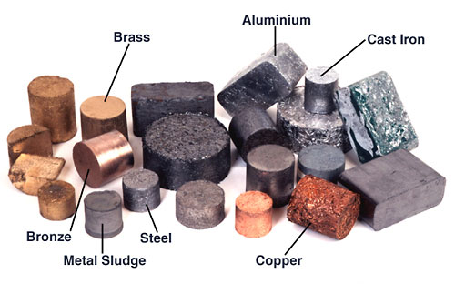
metals ---- nonmetals
Most are gases
Solids at room temp.
(except mercury)

Slide 9
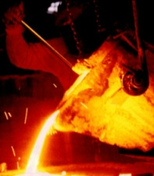
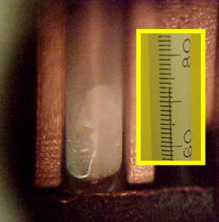
metals ----- nonmetals
lower melting points
higher melting points

Slide 10
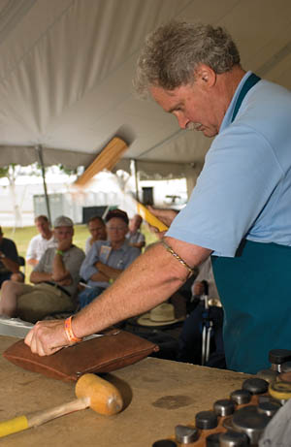
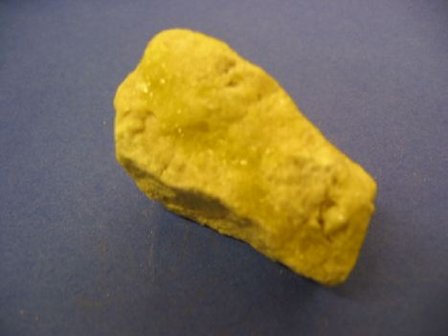
metals ---- nonmetals
brittle (break easily)
Softer than metals
malleable
(can be pounded & shaped)
harder

Slide 11
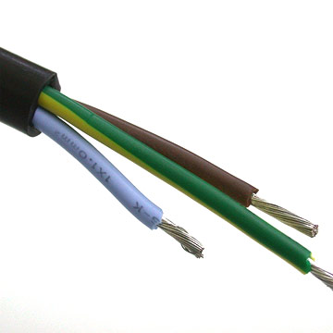
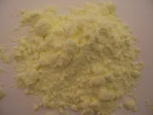
metals ---- nonmetals
Not ductile
Ductile
(can be drawn into wire)

Slide 12
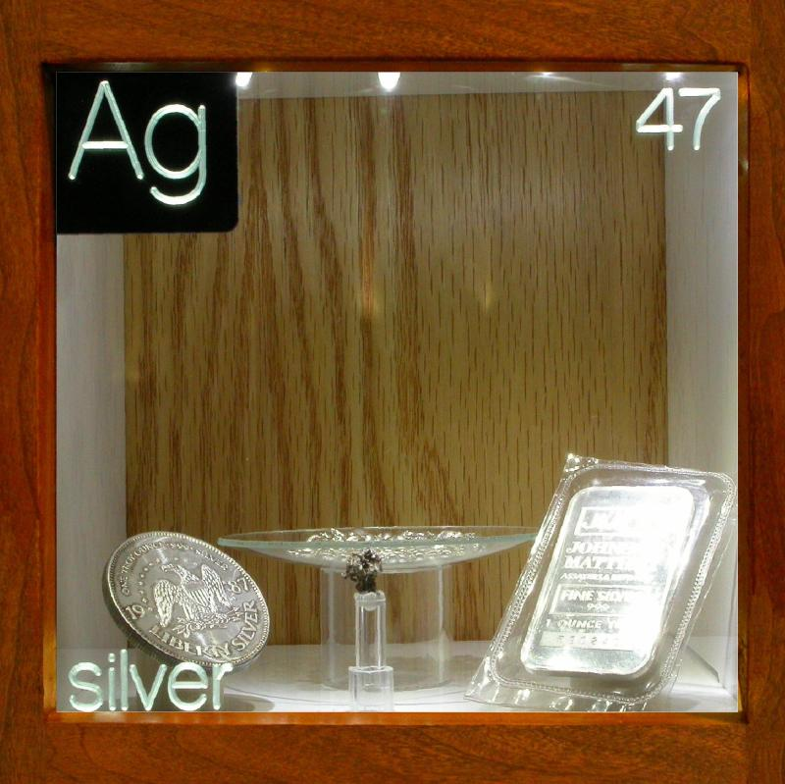
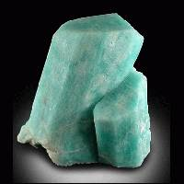
metals ---- nonmetals
dull
lustrous (shiny)

Slide 13
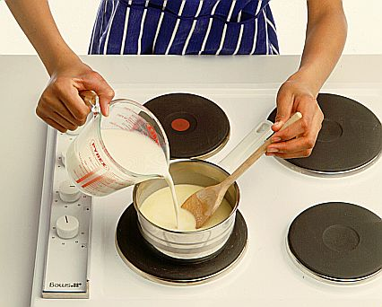
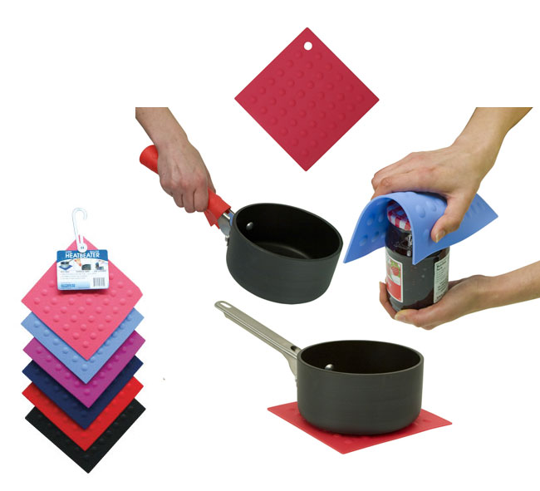
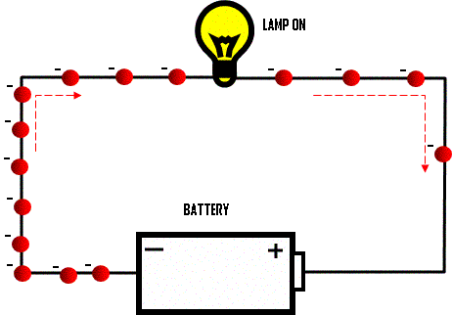
metals ---- nonmetals
Poor conductors
(good insulators)
Good conductors of
heat and electricity

Slide 14
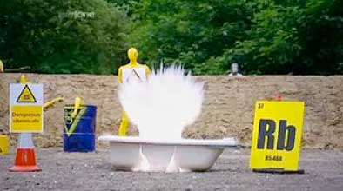
metals ---- nonmetals
Includes the least reactive group (18)
(noble gases)
*most stable
Includes the most
reactive group (1)
(alkali metals)
Brainiac Video (no commercials)
Backup copy on teachertube--with commercials

Slide 15
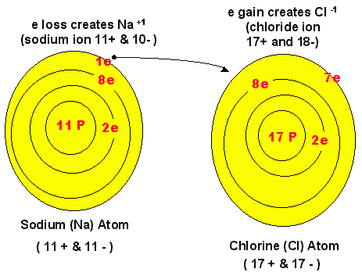
metals ---- nonmetals
Tend to lose electrons
(form positive ions +)
Tend to gain electrons (form negative ions -)

Slide 16
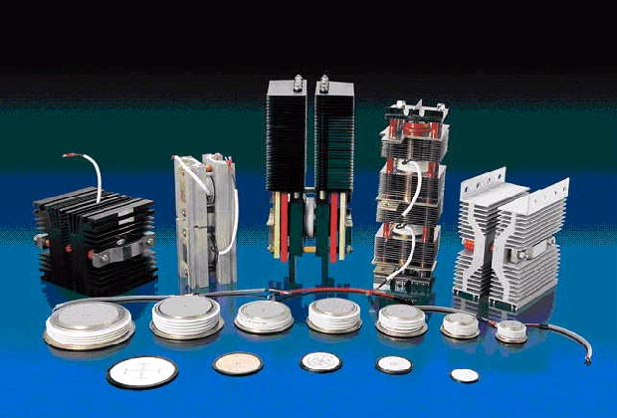
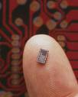
Metalloids
Have some of the properties of metals and some of the properties of nonmetals
Include semiconductors (Used in electronics)

Slide 17
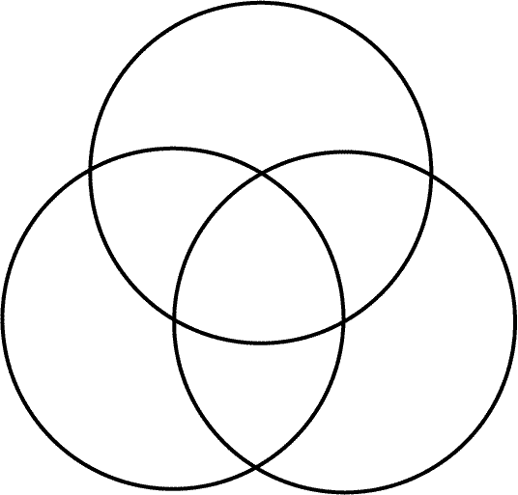
Metals
8
9
10
13
14
15
Nonmetals
2
6
12
Metalloids
4
5
7
16
17
3
18
1
11

Slide 18
Answer the Essential Question
On a sheet of lined paper or on the bottom of your guided notes
How can you use the Periodic Table to predict the properties of an element?

Slide 19
Exit Ticket
On the slip of paper
Have a great day

