Slide 1
Fossils
Wednesday, December 3rd, 2014

Slide 2
Do Now
The figure below shows fossils found in rock layers. There were no fossils found in the blank layers
Which rock layers have the same relative ages?
Which country has the older rock bed?
What inference can you make about the three layers of rock that contain trilobite fossils?

Slide 3
Objectives
SWBAT master the fossils unit on Study Island
SWBAT describe how an organism becomes a fossil by reading an article
Essential Question
How does an organism become a fossil?

Slide 4
Directions for today
Take notes on the directions for today

Slide 5
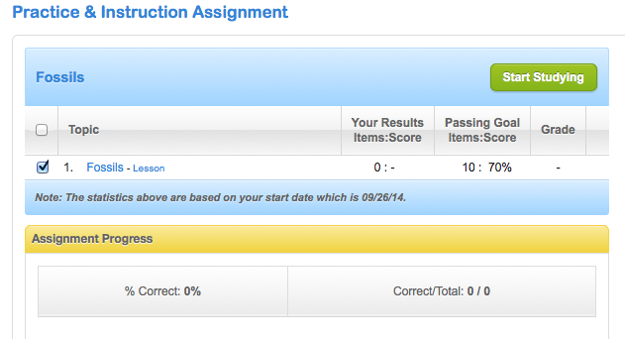
Study Island Directions
Step 1: View Lesson

Slide 6
View Lesson
Read pages 1 and 2
Page 3 is radioactive dating activity
Click on the image
Let it download
Click update later
Click run and it should open

Slide 7
Start Studying

Slide 8
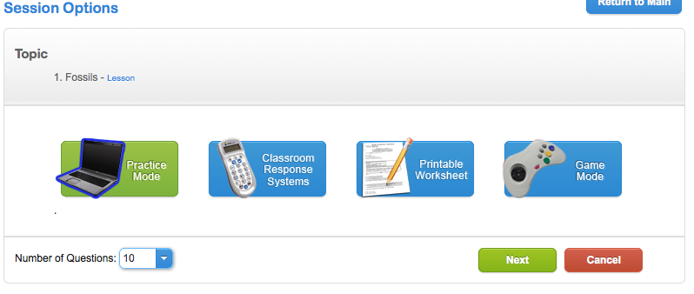
Number of Questions
Change number of questions to 20
Click next

Slide 9
After Study Island
http://www.livescience.com/37781-how-do-fossils-form-rocks.html
List and describe the various ways that an organism can become a fossil.

Slide 10
Answer the Essential Question
How does an organism become a fossil?

Slide 11
Exit Ticket

