Slide 1
Outcome of Chemical Changes
Friday, October 17th, 2014

Slide 2
Do Now
Homework
Read page 151 in the textbook and write the definitions of Endothermic and Exothermic in your vocabulary
Balance the chemical equation (take note of oxygens in each compound)
__KOH + __H₂SO₄ → __K₂SO₄ + __H₂O

Slide 3
Objectives
SWBAT identify the common outcome of ALL chemical reactions by analyzing chemical reactions.
Essential Question
What are the common outcomes of ALL chemical reactions?

Slide 4
Note sheet for today
Title: Common Outcome of All Chemical Reactions
Date: 10/23/2014

Slide 5
How atoms bond
You must answer your letter, I encourage you to answer 2
What happens when atoms bond?
What are the 2 types of bonds in the video?
What happens to electrons when atoms bond?
What can we conclude about ALL chemical bonds?

Slide 6
Why atoms bond
You must answer your letter, I encourage you to answer 2
Compare and contrast what happens to the people the first 2 times they bump into each other.
What is the chemical reaction? How do you know?
What has to be just right for a chemical reaction to occur?
What is a common outcome of ALL chemical reactions

Slide 7
Discussion
What did we conclude from these two videos about the common outcome of all chemical changes?
Electrons are shared or transferred
Chemical changes result in new substances.

Slide 8
Common outcome
Conservation of Mass
What is the law of conservation of mass?
UF₄ + 2Mg → 2MgF₂ + U

Slide 9
law of conservation of mass?
On your sheet of paper, write the definition of the law of conservation of mass.
How is the law of conservation of mass related to balancing chemical equations?
Crash Course Chemistry #6 Stoichiometry
Stoichiometry

Slide 10
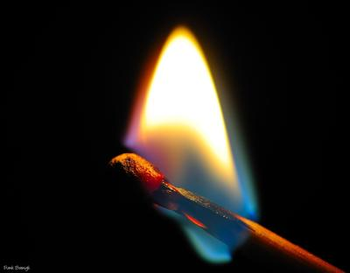
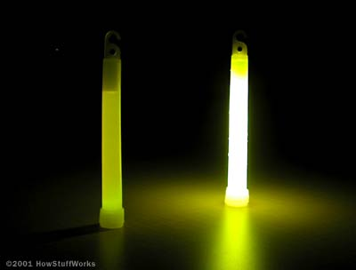
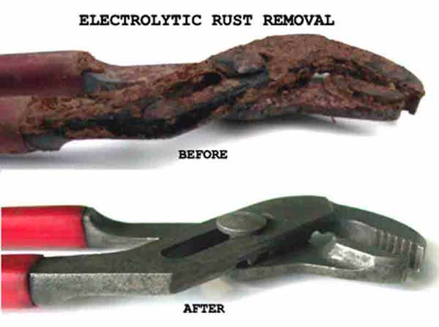
Products are chemically different than the reactants.
They have different chemical
and physical properties

Slide 11
Common outcome of all chemical reactions
Thumbs up for yes, thumbs down for no
For it to be yes it needs to happen in ALL chemical reactions
not it CAN happen in chemical reactions

Slide 12
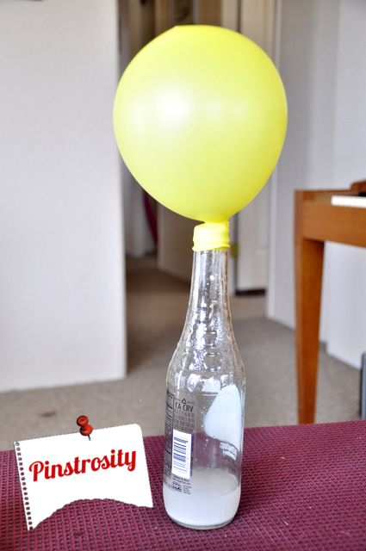
Formation of gas?

Slide 13
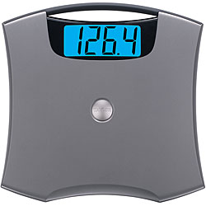
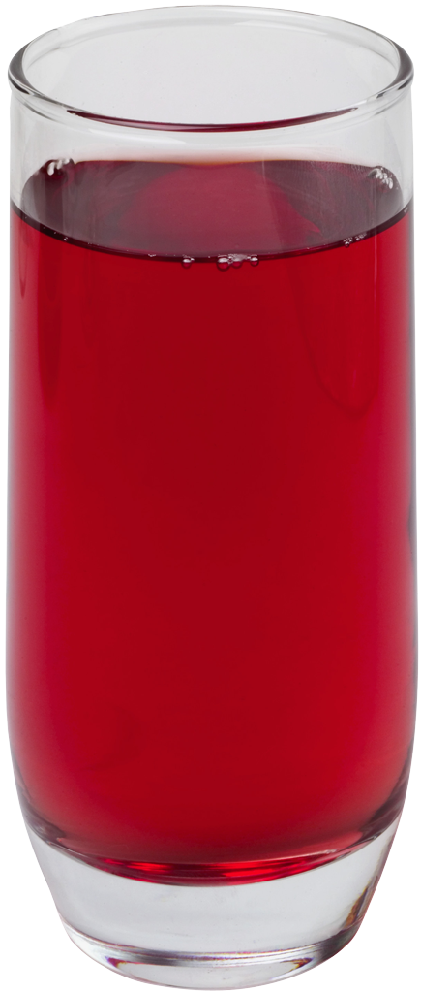
Same mass before and after

Slide 14
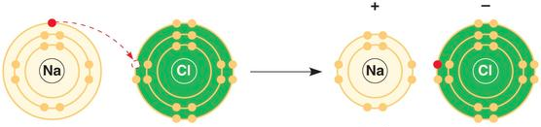
sharing or transferring of electrons?

Slide 15
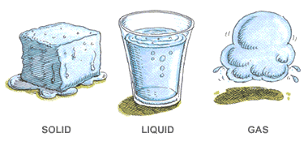
Change of State?

Slide 16
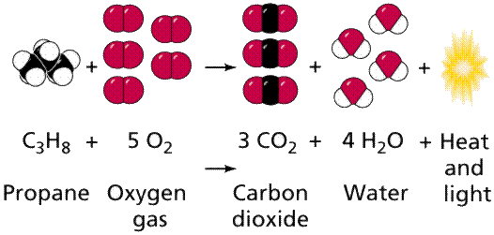
New chemical bonds are formed

Slide 17
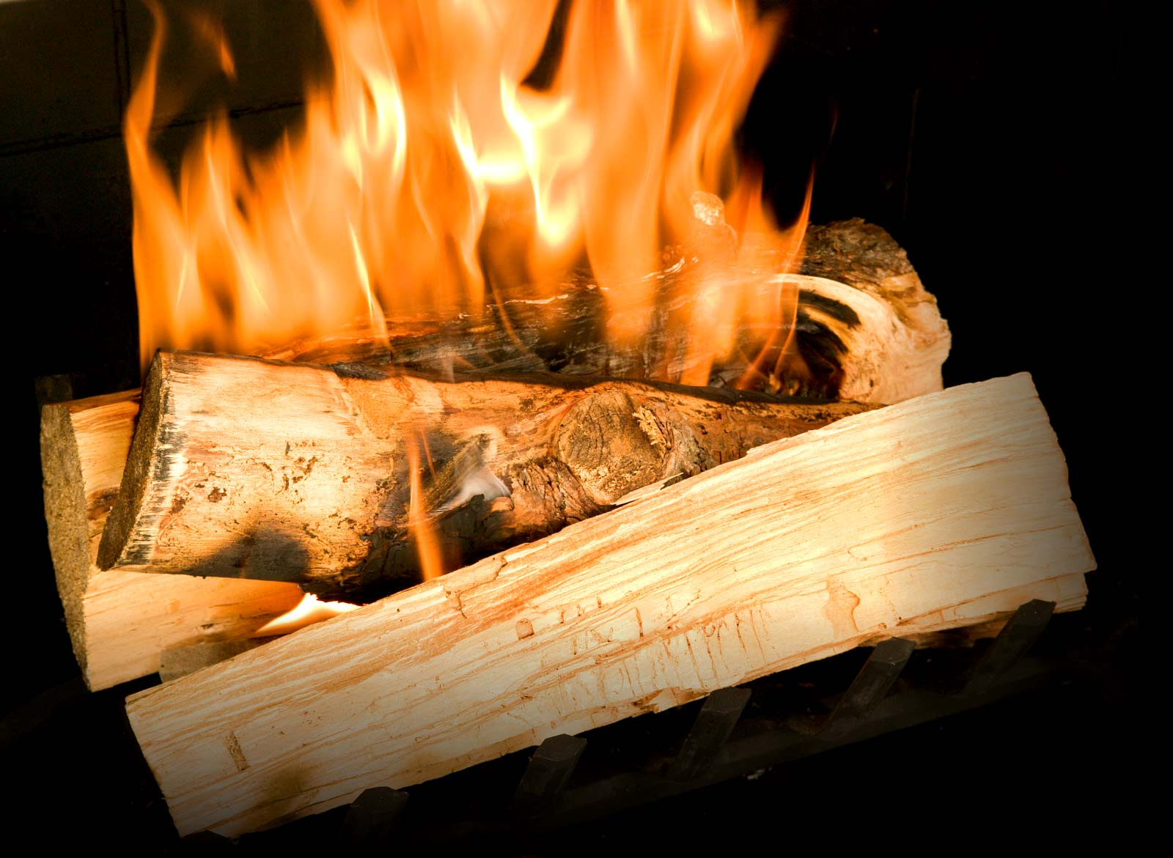
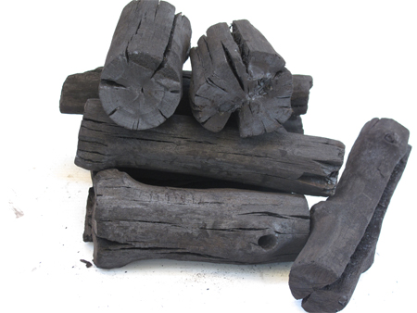
New substance is formed

Slide 18
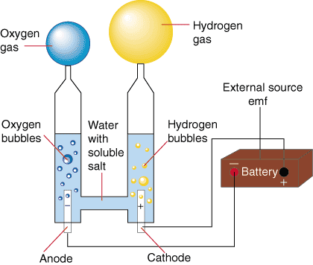
Reversible?
Process of electrolysis turns water into oxygen and hydrogen
Process of combustion turns hydrogen and oxygen into water

Slide 19
Answer the Essential Question
What are the common outcomes of chemical reactions?

Slide 20
Essential Queston
The common outcome of all chemical reactions
Atomic level
New chemical bonds are formed
Electrons are transferred
Macroscopic level
Mass of the reactants is the same as the mass of the product
conservation of mass
New substances are formed

Slide 21
Exit Ticket
Complete the following statements
In all chemical reactions
What do electrons do?
Reactants and products…
The mass before and after a reaction…

Slide 22
Sign the Petition
There is a chemical called dihydrogen monoxide in the city’s water pipes
Major component in acid rain
Contributes to greenhouse effect
May cause severe burns
Contributes to erosion of landscape
Accelerates rusting
Has been found in tumors of cancer patients
Can lead to vomiting and diarrhea
Will you sign the Petition?

Slide 23
What is it?
Dihydrogen
2 hydrogen
Monoxide
1 oxygen
H₂O
WATER!!!

