Slide 1
Natural Selection
Tuesday, January 20th, 2014

Slide 2
Do Now
Homework
Test on Friday
Study session at 8 in this room on Friday morning.
Do Now
What is the most confusing concept from this unit?
What are 3 examples of traits that might be favorable to animals or plants?
Motivation Monday Tuesday

Slide 3
Objetives
SWBAT describe natural selection by watching a BrainPop.
SWBAT predict which populations are likely to survive in a particular environment by analyzing data.
Essential Question
How does natural selection change a population?

Slide 4
BrainPop
What did Charles Darwin notice? What were his examples
What are mutations?
Describe what happens to the reef fish.
Why does Darwin compare organisms to a giant tree of life?

Slide 5
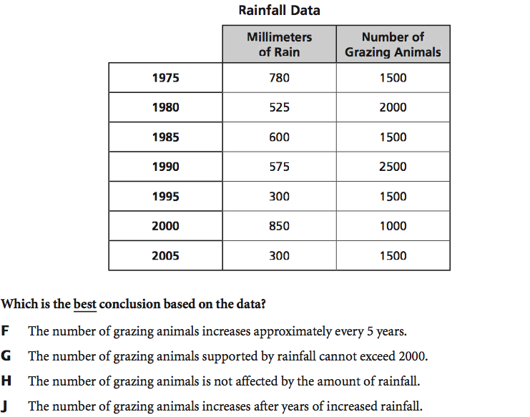
Analyzing data

Slide 6
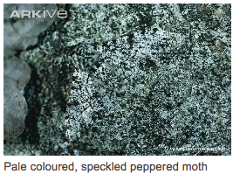
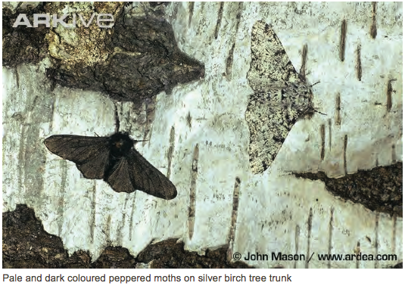
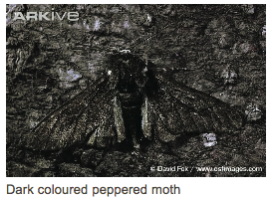
The Peppered Moth

Slide 7
Answer the Essential Question
How does natural selection change a population?

Slide 8
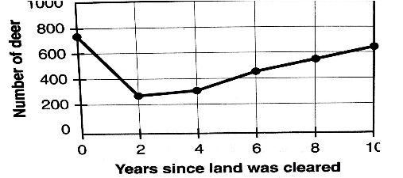
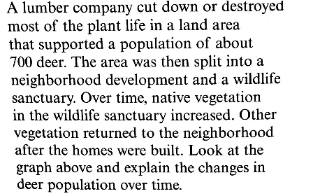
Exit Ticket
The deer population fell in the neighborhood and rose in the sanctuary
The deer population fell with the loss of vegetation and rose with the increase of vegetation
The deer population continued to increase despite the loss of vegetation
The amount of vegetation had no effect on the deer population

