Slide 1
Review the Periodic Table
Tuesday, September 30th, 2014

Slide 2
Do Now
What do you remember about the Periodic Table of Elements?
How to read the periodic table?
Who created the table?
What are the groups and what are the properties?
I want you to be writing the whole time and using complete sentences

Slide 3
Objectives
SWBAT review the Periodic Table unit
Essential Question
How do we know the properties of the elements based on their location on the Periodic Table?

Slide 4
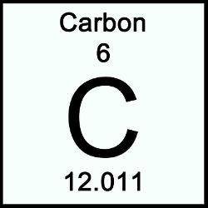
Reading the elements
Element
Name
Note:
Atomic number
is always the
smaller number
Atomic
Number
Element
Symbol
Atomic Mass
(average)

Slide 5
Number of protons: 6
(Same as atomic number)
Number of neutrons: 12-6=6
(Rounded atomic mass – atomic number)
Number of electrons: 6
(Same as atomic number)

Slide 6
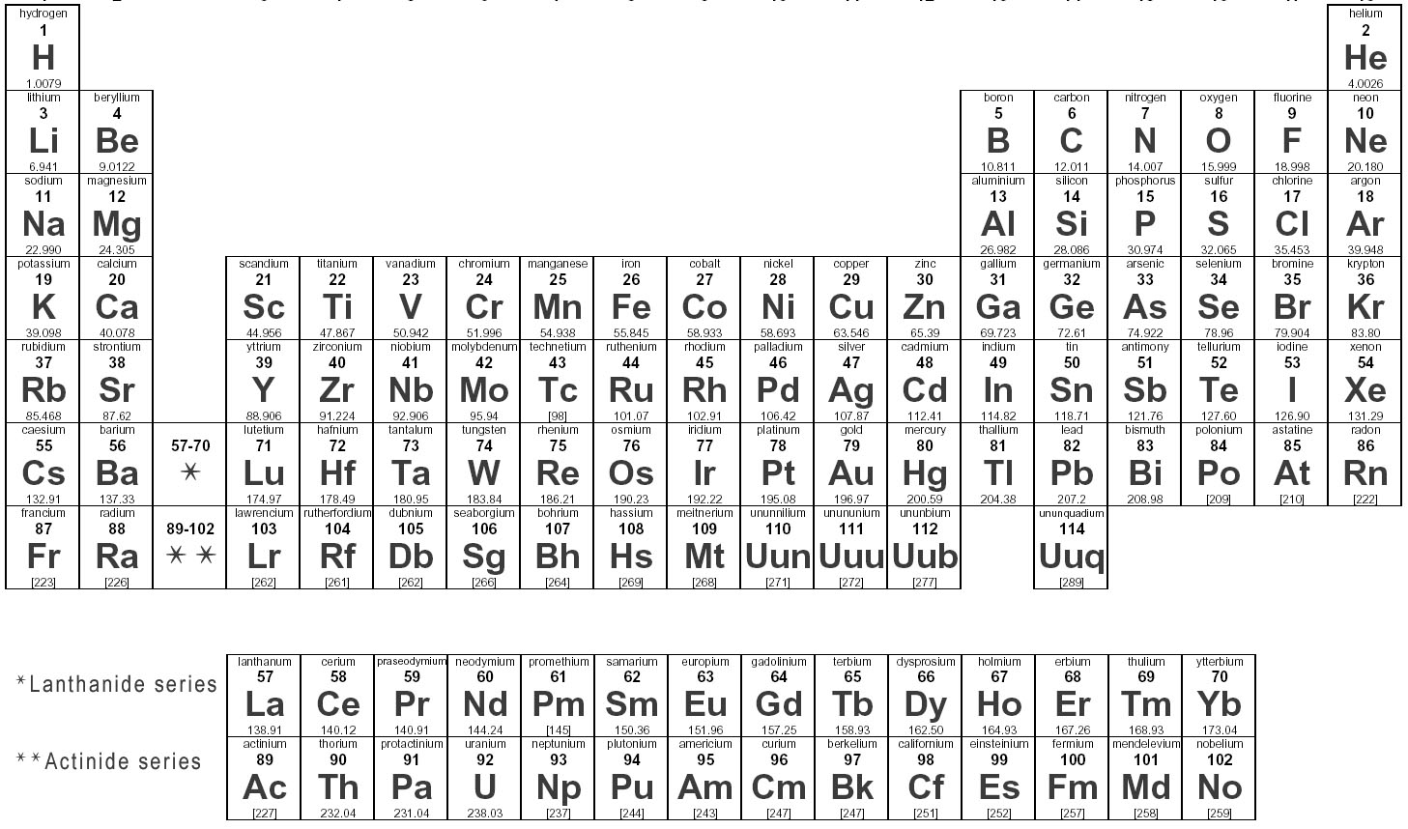
Periods
1
2
3
4

Slide 7
Groups
1
18
2
17
3

Slide 8
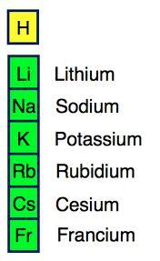
Alkali Metals
Alkali metals are located in ________ at the far left side of the periodic table. Note that ___________ is not an alkali metal. All of the Alkali metals have __________________ in their outer shell. This is what gives them similar __________. Alkali metals are ________ __________ and are not found in their ___________ in nature. They are also all ______ at room temperature There are 6 Alkali Metals with symbols of ____, ____, ____, ____, ____, and ____
group 1
Hydrogen
1 valence electron
properties
highly
reactive
pure form
solids
Li
Na
K
Rb
Cs
Fr

Slide 9
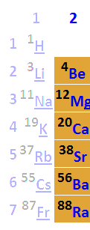
Alkaline Earth Metals
The Alkaline Earth Metals are located in ________, just to the right of the Alkali Metals. All of the Alkaline Earth Metals have _________________in their outer shells. Alkaline Earth Metals are still _________ but not as reactive as the _____________. These are sometimes found in their pure form in nature as _______. The 5 Alkaline Earth Metals are ___, ___, ___, ___, ___ and ___
group 2
2 valence electrons
reactive
Alkali Metals
solids
Be
Mg
Ca
Sr
Ba
Ra

Slide 10
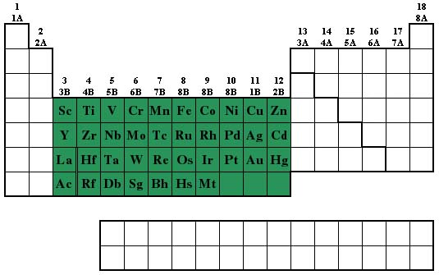
Transition Metals
The transition metals are located in the ________ of the Periodic Table from ___________________. The number of _________________ for the Transition Metals _______, but stays the same for each __________. Transition Metals are all _______ at room temperature except for __________.
middle
group 3 to group 12
valence electrons
varies
element
solids
Mercury

Slide 11
Transition Metals
They are good ___________ of heat and electricity, ___________, shiny, and are ____ very reactive. They still _____ with other elements but ___________as the Halogens, Alkali Metals, or Alkaline Earth Metals. These metals are what we _____________ as metals in our daily lives. There are many Transition Metals but some examples are ___________, __________, ___________, _______________
conductors
malleable
not
react
not as much
recognize

Slide 12
Halogens
group 17
The Halogens are located in _________ in the 2nd to the last column on the right. All of the Halogens have __________________ so they just need ____________ to fill their outer shell. Halogens are _________________ and usually react with the _____________. This is because the Alkali Metals need to ____ 1 electron and the Halogens need to ____ 1 electron. The halogens are all ___________and are usually gases at room temperature. There are 5 Halogens with the element symbols ___, ___, ___, ___, and ___
7 valence electrons
1 electron
extremely reactive
Alkali Metals
lose
gain
nonmetals
F
Cl
Br
I
At

Slide 13
Noble Gases
The Noble Gases are located all the way to the right of the table in __________. The Noble Gases are _________because they are ______________. The Noble Gases have ___________ in their outer shell and don’t need to ____________ any electrons. The Noble Gases are all _______________ and are commonly found in their ___________ in the atmosphere. There are 6 Noble Gases with symbols ___, ___, ___, ___, ___, and ___.
group 18
unique
non-reactive
8 electrons
lose or gain
colorless gases
pure form
He
Ne
Ar
Kr
Xe
Rn

Slide 14
Metals, Nonmetals, and Metalloids
Metals | Nonmetals | Metalloids
Shiny luster Malleable Ductile Good conductor of heat/electricity Solid | Dull Brittle Good insulator Liquid/gas | Semiconductor Use in electronics

Slide 15
Isotopes
Atomic
Mass
Atomic
Mass
Atomic
Number

Slide 16
TCAP sample questions
I am going to show you 6 questions that relate to the standard about the Periodic Table
SPI 0807.9.9 Use the periodic table to determine the properties of an element.
There will be 1-2 questions on this standard for the TCAP
Please let everyone answer each question by refraining from shouting out the answers and helping each other.
Please explain how you know that it is the right answer and how you know the other answers are incorrect

Slide 17
A group from the Periodic Table is shown
What is the atomic number of Fluorine

Slide 18
Answer
9
The atomic number is always the smaller one
The atomic number is the number of protons
Protons + neutrons = atomic mass (the other number)

Slide 20
Answer
Correct answer is C.
Halogens (F) are very reactive
Eliminates A, B, and D

Slide 22
Answer
A – Li
Li – 6.94
Be – 9.01
Ca – 40.08 – also not in period 2
Ne – 20.18

Slide 23
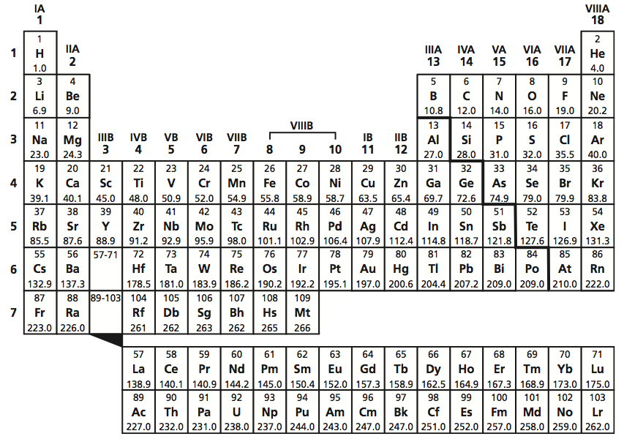
Based on their locations on the periodic table, which two elements share the most similar chemical properties?
K and Kr
Be and Ba
S and Sn
H and I

Slide 24
Answer
B – Be and Ba
These are both alkaline earth metals
All other answers are not in the same group
Similar groups have similar properties

Slide 25
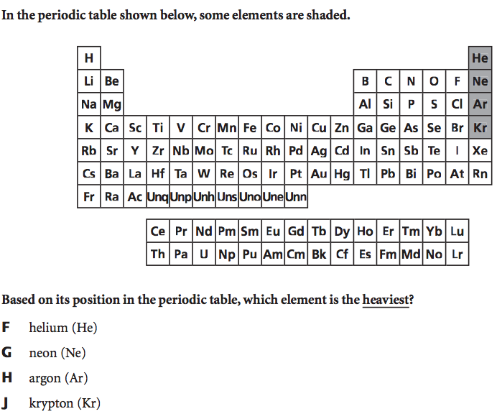

Slide 26
Answer
D – Krypton (Kr)
Starting from the top left, the elements atomic number and atomic mass (how heavy it is) increases

Slide 27
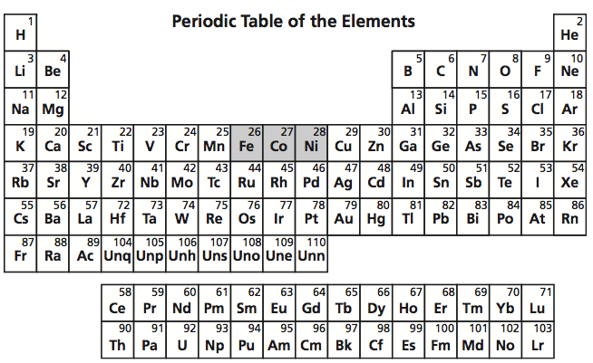
A property that the elements Fe, Co, and Ni have in common is that they are all
Chemically inert
Halogens
Transition metals
Poor electrical conductors

Slide 28
Answer
C – Transition metals
Not A because inert means non-reactive. Transition metals are some of the least reactive elements but they do still react with other elements
Not B because the Halogens are on the right side (F, Cl, Br, I, and At)
Not D because metals are good conductors of electricity

Slide 29
Physical Science Questions
These next questions are from the Physical Science Standards
3202.1.9 Distinguish between atomic number and atomic mass.
3202.1.10 Define an isotope and describe the use of common isotopes.
3202.1.11 Identify the number of protons, neutrons, and electrons in an atom of an isotope based on its atomic number and atomic mass.
3202.1.12 Know the chemical symbols for the common elements.
3202.1.13 Use the periodic table to determine the number of protons, neutrons, and electrons in an isotope of an element.
3202.1.14 Use the periodic table to identify the characteristics and properties of metals, non-metals, and metalloids.

Slide 30
9 – Atomic number vs. atomic mass
10 – What is an isotope and how are they used
11 – Protons, neutrons, and electrons based on atomic mass and atomic number
12 – Know the chemical symbols for the common elements
13 - properties of metals, nonmetals, and metalloids

Slide 31
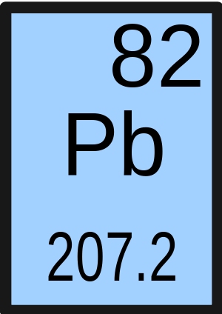
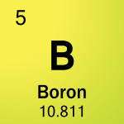
Identify the atomic number and atomic mass in each element
83.08
Kr
Krypton
36

Slide 32
Answers
Pb
Atomic number – 82
Atomic mass – 207.2
Kr
Atomic number - 36
Atomic mass – 83.08
B
Atomic number – 5
Atomic mass – 10.811
The individual elements on a periodic table will be arranged in various ways
The smaller number is always the atomic number
The larger number is always the atomic mass

Slide 33
An isotope is an atom of the same __________ with a different number of _____________.
State of matter, protons
Element, neutrons
State of matter, neutrons
Element, protons

Slide 34
Answer
C- An isotope is an atom of the same element with a different number of neutrons.
If the number of protons are different the atom is a different element
State of matter is dependent on temperature

Slide 35
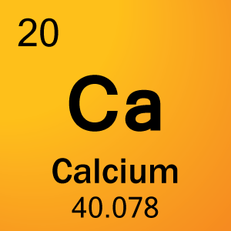
How many protons, neutrons, and electrons are in the following atoms
O
18
8

Slide 36
Answers
Ca
Protons - 20
Neutrons – 20
Electrons – 20
O
Protons – 8
Neutrons – 10
Electrons - 8

Slide 37
Match the element name with its symbol
Hydrogen
Helium
Carbon
Magnesium
Sulfur
Nitrogen
Oxygen
Sodium
Calcium
Chlorine
C
Mg
Ca
O
Cl
S
He
Na
N
H

Slide 38
Answers
J
G
A
B
F
I
D
H
C
E

Slide 39
I am a solid at room temperature, malleable, very reactive, and is in period 3. Which element am I?

Slide 40
Answer
Sodium (Na)
Solid at room temperature
Eliminates the nonmetals
Malleable
Still eliminates the nonmetals
Very reactive
Can either be alkali metal or alkaline earth metal but alkali metals are more reactive
Period 3
Must be Sodium

Slide 41
I am a gas at room temperature, I don’t react with any other elements, and I am 1 out of every 100 atoms in the atmosphere

Slide 42
Answer
Argon (Ar)
Gas at room temperature
Must be a nonmetal
Don’t react with other elements
Must be a noble gas
1% of atmosphere
Argon

Slide 43
Create your own
With an element in mind, give 3 clues of physical properties, chemical properties, and location on the periodic table

Slide 44
Answer the Essential Question
How do we know the properties of the elements based on their location on the Periodic Table?
Group/family
Period
Metal, nonmetal, metalloid

Slide 45
Exit Ticket
Which 2 elements have the most similar properties?
Hydrogen (H) and Helium (He)
Argon (Ar) and Oxygen (O)
Calcium (Ca) and Magnesium (Mg)
Silicon (Si) and Boron (B)
How do you know that these elements have the most similar properties?
How many questions did you get correct from the handout?

